Slide 1





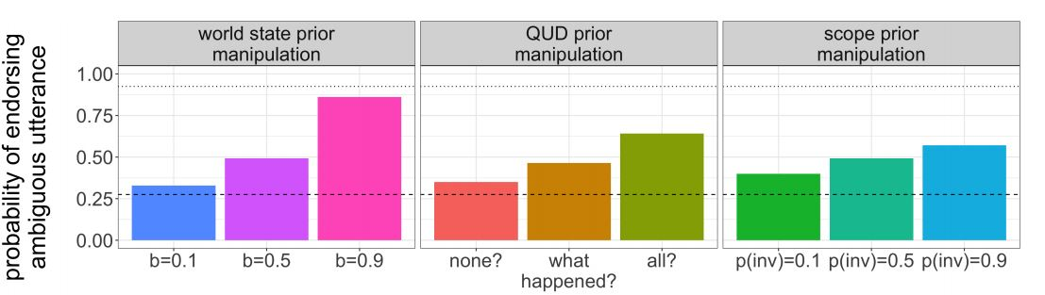
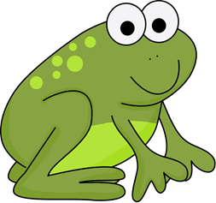

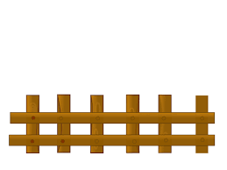




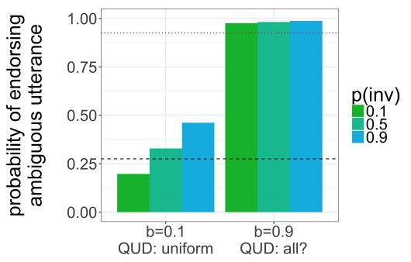
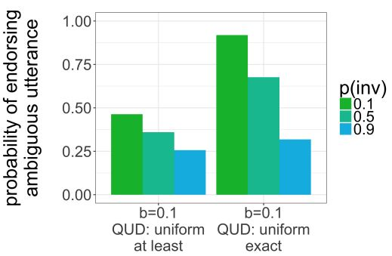
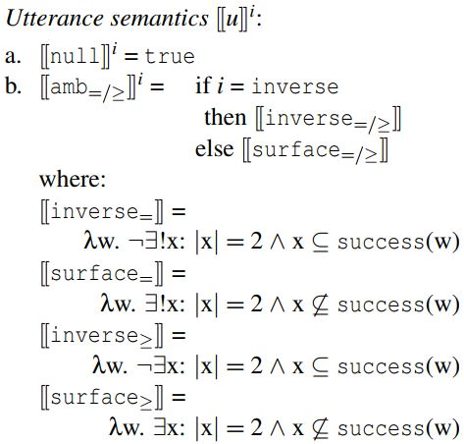
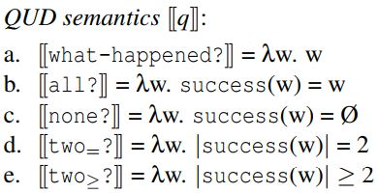



Exactly two things to learn from modeling scope ambiguity resolution:
Developmental continuity and numeral semantics
K.J. Savinelli, Gregory Scontras, and Lisa Pearl
University of California, Irvine
The linguistic phenomenon: scope ambiguity
Open question
Results
every-not: Every horse didn’t jump over the fence.
a. ∀ >> ¬ (surface scope):
None of the horses jumped over the fence.
b. ¬ >> ∀ (inverse scope):
Not all of the horses jumped over the fence.
Developmental continuity: Are child and adult ambiguity resolution behavior qualitatively similar? (= same underlying mechanisms)
Why does the explicit contrast clause work for adults with two-not?
What causes the asymmetry in adult behavior across the two contexts?
Pragmatics drives explicit contrast behavior
A truth-value judgment task (TVJT) measures utterance endorsement:
Our contributions
two-not
Adults:
27.5% to 92.5%
90-100% endorsement
Extend model from Savinelli et. al. (2017) to capture adult ambiguity resolution behavior in context.
We support developmental continuity if the same model can account for children’s behavior with every-not and adult behavior with two-not
Adults
Replication of previous work modeling children’s behavior with every-not: pragmatic factors impact behavior more than grammatical factor of scope
2-of-3 context:
surface is false and
inverse is true
10-20%
endorsement
Children
The Model
Which combination of settings captures adult behavior?
explicit contrast manipulation
asymmetry in 1-of-2 vs. 2-of-4
Background
Interpretations:
i ∊ {surface,inverse}
QUDs:
q ∊ {how-many?,all?,none?,
at-least-two?,exactly-two?}
World states:
w ∊ {0,1,2} or {0,1,2,3,4}
Utterances:
u ∊ {two-not,null}
Why do children behave differently than adults?
Savinelli et. al. (2017) articulated a computational model of utterance endorsement that incorporated several pragmatic and grammatical factors.
Bayesian Rational Speech Act (RSA) framework (Goodman & Frank, 2016):
World states correspond to the number of successful jumpers
Baserate (b) determines the probability of a successful jump
Pragmatic speaker chooses whether to endorse two-not as a description of the observed state
Separate predictions for 1-of-2 vs. 2-of-4 contexts
In the 1-of-2 contexts:
Q = {how-many?, all?, none?}
Unambiguous numeral meaning
In the 2-of-4 contexts:
Ambiguity in the interpretation of two: at-least-two semantics vs. exactly-two semantics
Additional QUDs: at-least-two? and exactly-two?
language understanding as recursive social reasoning
ambiguity resolution modeled as pragmatic inference
two-not
Adults: 27.5% to 92.5%
two-not
Adults: 100%
TVJT behavior modeled as utterance endorsement (Degen & Goodman, 2014; Tessler & Goodman, 2016): A pragmatic speaker observes the state of the world and decides whether to describe it with the every-not utterance
Changing the two pragmatic factors best captures the observed adult behavior in 1-of-2 contexts:
Success baserate from 0.1 to 0.9
From no QUD favored to favoring all?
The same pragmatic parameter settings (b = 0.1, uniform QUD prior) that yield low 1-of-2 endorsement yield high 2-of-4 endorsement if inverse scope is unlikely (p(inv) = 0.1) and the semantics of the numeral is exact.
Upshot: Pragmatic factors of world knowledge and beliefs about the question under discussion (QUD) play a stronger role than the grammatical factor of scope access when disambiguating every-not.
But adults sometimes behave like children, too..
two-not: Two frogs didn’t jump over the rock
a. 2 >> ¬ (surface scope):
Two frogs are such that they didn’t jump.
b. ¬ >> 2 (inverse scope):
It is not the case that two frogs jumped.
Discussion
Our model of ambiguity resolution in context that previously captured children’s behavior seamlessly extends to capture adult behavior:
Evidence of developmental continuity in scope ambiguity resolution
Also explains why the explicit contrast manipulation works: the pragmatic factors create a situation where two-not is still quite informative and therefore useful despite the ambiguity
Also supports exactly-two utterance semantics to explain adult asymmetry in endorsement behavior across contexts
Underscores the complexity of the utterance disambiguation:
A confluence of factors contribute to how these ambiguities get resolved
It appears that pragmatics has a more profound effect on behavior, but grammatical scope access still matters (especially for adult behavior!)
Computational modeling can help us refine our theories about language representation:
Here: We can manipulate the semantics of two and test the relevant predictions in ways behavioral experiments alone cannot
Musolino & Lidz (2003) show that adults refuse to endorse two-not utterances in certain contexts:
Default Values:
P(w) ∝ baserate = 0.5
P(q) = uniform
P(i = surface) = 0.5
Manipulated values:
Baserate ranges from 0.1 to 0.5 to 0.9
P(q=favored) = 0.9
1-of-2 context:
surface is false and
inverse is true
2-of-4 context:
surface is true and
inverse is false
two-not
27.5% endorsement
two-not
100% endorsement
explicit contrast +
two-not
92.5% endorsement
References: Judith Degen and Noah D Goodman. 2014. Lost your marbles? the puzzle of dependent measures in experimental pragmatics. In Proceedings of the Annual Meeting of the Cognitive Science Society. volume 36, pages 397–402. http://escholarship.org/uc/item/97t2w1f3. Noah D Goodman and Michael C Frank. 2016. Pragmatic language interpretation as probabilistic inference. Trends in Cognitive Sciences 20(11):818–829. Julien Musolino and Jeffrey Lidz. 2003. The scope of isomorphism: Turning adults into children. Language Acquisition 11(4):277–291. K.J. Savinelli, Gregory Scontras, and Lisa Pearl. 2017. Modeling scope ambiguity resolution as pragmatic inference: Formalizing differences in child and adult behavior. In Proceedings of the Annual Meeting of the Cognitive Science Society. volume 39, pages 3064–3069. Michael Henry Tessler and Noah D. Goodman. 2016. A pragmatic theory of generic language.
Two frogs jumped over the fence, but…

